Slide 1
ICM Overview and Scripting
5th February 2016

Slide 2
Agenda
  Demonstrate an overall understanding of the Cisco ICM system and environment
  Describe the features, functions and capabilities of Cisco ICM
  ICM call flow
  Configure a Cisco ICM system using the Configuration Manager tool
  ICM variables – Call control variables, ECC and user variables
  Nodes in ICM scripting
  Create call routing script using the Script Editor tool
*Copy and paste this text box to enter notations/source information. 7pt type. Aligned to bottom. No need to move or resize this box.
Title of presentation goes here

Slide 3
Introduction
Cisco ICM system and Environment

Slide 4

Cisco ICM
Cisco ICM delivers intelligent call routing, multichannel contact management and network-to- desktop computer telephony integration (CTI)
Segments the customers, monitors resource availability and delivers each contact to the most appropriate resource anywhere in the enterprise
  Features and Benefits
  Cisco Pre-Routing and Post-Routing Functions
  Customer Profile Routing
  Computer Telephony Integration Option
  Customer Relationship Management (CRM) Integration
  Cisco Unified Web Interaction Manager
  Cisco Unified E-Mail Interaction Manager
  IVR Integration
  Enterprise Reporting
  Distributed Fault Tolerance
  Multicarrier, Multivendor Capabilities
  Scalability
  Security

Slide 5
Core Capabilities
Queuing and Routing
Skill based , Application and DB based routing
Multichannel Routing
Outbound campaign management
Queuing
Administration
Common agent configuration across channels
Streamlined multi-channel administration
Synchronization and verification of configuration
CTI and APIs
Agent desktop – out of box and toolkit
Open social gadgets
CRM integration
Reporting
Web based reporting
Real time and historical reports
Multichannel
Customization
Title of presentation goes here

Slide 6
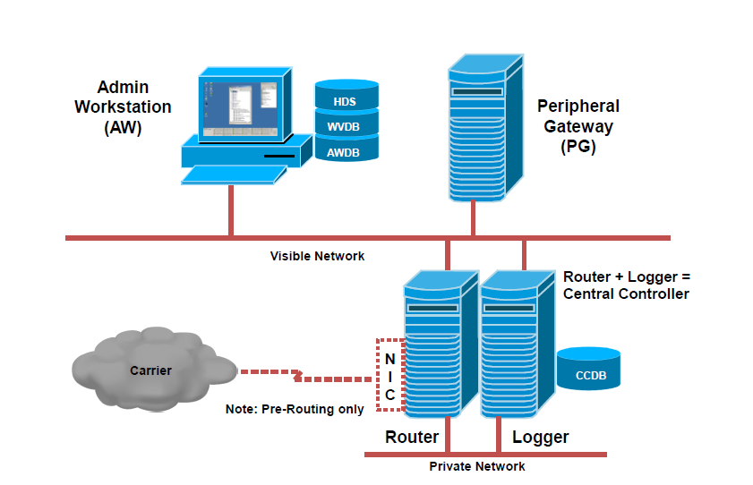
ICM Components
  Core ICM software components include:
  Call Router
  Logger
  Peripheral Gateway (PG)
    Peripheral Interface Manager (PIM)
    CTI Server
    CTI Object Server (CTI OS)
  Administration and Data Server
    Administration Server and Real-Time Data Server (AW)
    Configuration-Only Administration Server
    AW-HDS-DDS
    AW-HDS
    HDS-DDS
    Administration Client (no local database)
*Copy and paste this text box to enter notations/source information. 7pt type. Aligned to bottom. No need to move or resize this box.
Title of presentation goes here

Slide 7
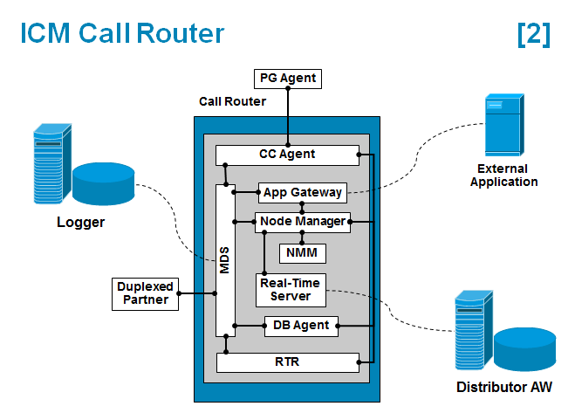
ICM Call Router
  Brain of the System
  Makes all routing decisions on how to route the call by executing the User-created Unified ICM Routing Scripts
  Runs in synchronized execution with its peer
  Maintains same memory image of the state of all the agents, calls and events in the system
  Routers keep the information updated by passing the state events between the servers on the Private LAN connection
*Copy and paste this text box to enter notations/source information. 7pt type. Aligned to bottom. No need to move or resize this box.
Title of presentation goes here

Slide 8
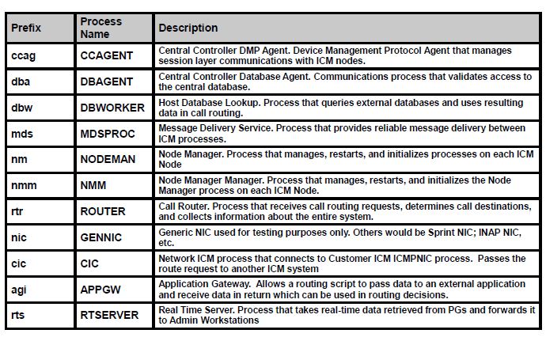
Router Processes

Slide 9
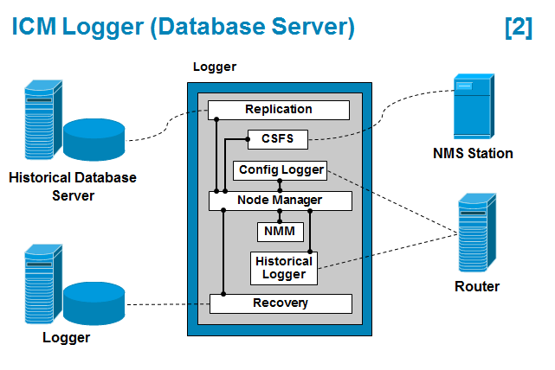
ICM Logger
  The Unified ICM Logger maintain the system database for the configuration (Agent ID’s, skill groups, Call Types and so forth) and scripting as well as the Historical data from call processing
  The loggers receive data from their local Call Router Process to store in the system database
  Logger data is also synchronized
  The logger provides replication of its Historical Data to the customer Historical Database Server (HDS) Administrative workstations over the Visible Network
*Copy and paste this text box to enter notations/source information. 7pt type. Aligned to bottom. No need to move or resize this box.
Title of presentation goes here

Slide 10
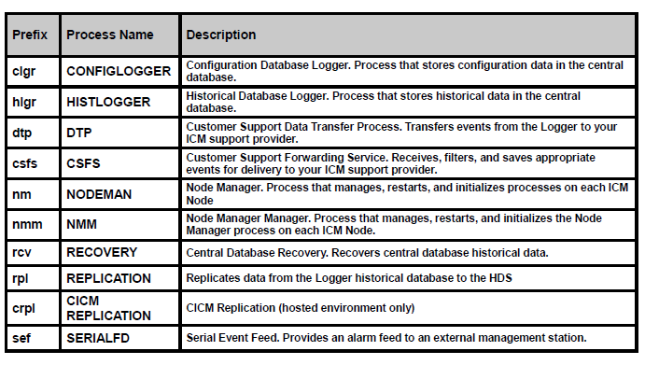
Logger Processes

Slide 11
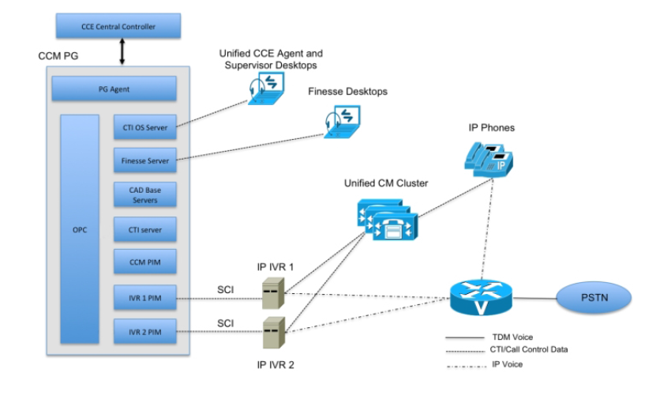
Peripheral Gateway (PG)
  Part of ICM Software that communicates directly with the local Switch within a Call Centre
  Each ACD, VRU that receives call from the ICM Software must be associated with a PG
  Peripheral Interface Manager (PIM)
    CM PIM/ VRU PIM
  CTI Server
  The CTI Server monitors the data traffic of the Unified CM PIM on the Agent PG for specific CTI Messages (Such as Call-ringing or off-hook events) and makes those messages available to CTI Clients such as the CTI OS server or the Cisco Agent Desktop Enterprise server
  CTI OS Server
  CTI OS server is a client of the CTI Server and is designed to monitor both CTI Servers in a duplex environment and maintain the agent state during failover processing
  PG operate in Hot Standby Mode for fault Tolerance
*Copy and paste this text box to enter notations/source information. 7pt type. Aligned to bottom. No need to move or resize this box.
Title of presentation goes here

Slide 12
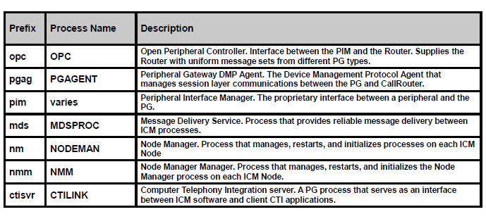
PG Processes

Slide 13
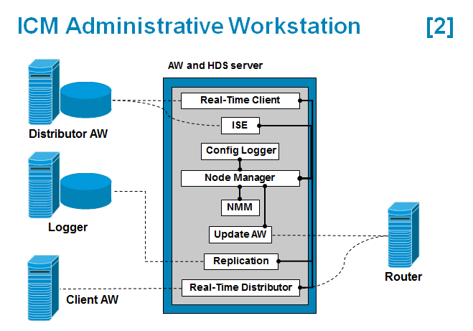
Administration and Data Server
  AW provides the user interface to the system for making configuration and Scripting changes
  The Administrative Workstation (AW) Real-Time Distributor (RTD) are clients of the Unified ICM Call Router real-time feeds that provides real-time information about the Unified CCE across the enterprise
  The HDS stores historical data summarized in 15 or 30 minute intervals and is used for reporting
  DDS stores detailed information about each call or call segment and is used for call tracing. Data may be extracted from either of these sources for warehousing and custom reporting
*Copy and paste this text box to enter notations/source information. 7pt type. Aligned to bottom. No need to move or resize this box.
Title of presentation goes here

Slide 14
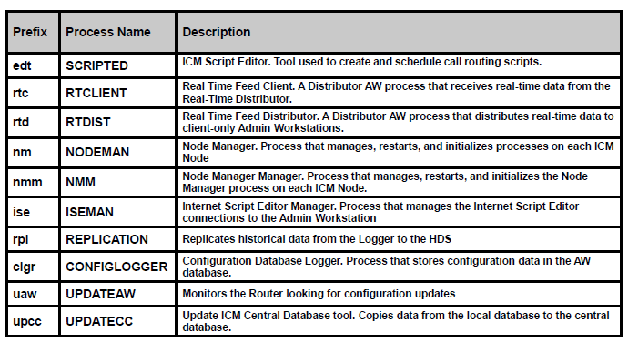
AW Processes

Slide 15
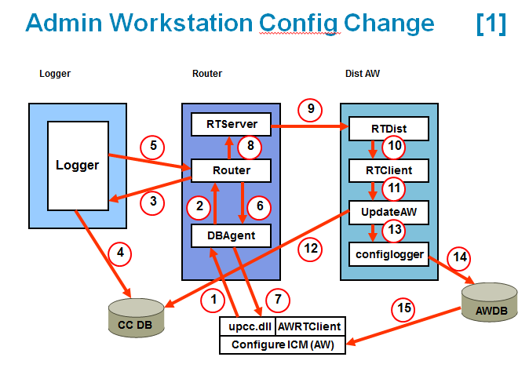
AW Configuration change
  Changes made are sent to the DBAgent on the call router
  DBAgent sends the change to the RTR
  RTR forwards the change to the LGR process
  Logger process commits the change to Central controller database
  Once committed to database, logger updates router with the new configuration data
  Router confirms change to dbagent
  The router confirms change to AW
  RTR tells RTServer to broadcast to all distributors that there has been a configuration change
  RTServer broadcast to all servers that there has been configuration change
  RTDist notifies RTClients of configuration change
  RTDist also notifies UpdateAW about config change
  UpdateAW connects to CC Database , copies the change
  Passes the data to Configlogger process
  Configlogger writes data to local AW database
  If someone opens config manager , they get data from AWDB

Slide 16
ICM Installation
  Prerequisites
    Network – Public and Private
    Servers – virtualization
    Database – SQL
  Domain
    Domain Manager Tool
    Cisco Root OU
    Facility
    Instance
    Systems to be part of domain
  ICM Components software installation
    For Logger and AW – Database creation using ICMdba under UCCE Tools
  PG Setup
    Before a PG is deployed, we need to configure PG in PG Explorer in Configuration Manager for Peripheral and Logical controller ID
*Copy and paste this text box to enter notations/source information. 7pt type. Aligned to bottom. No need to move or resize this box.
Title of presentation goes here

Slide 17
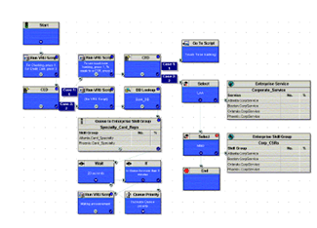
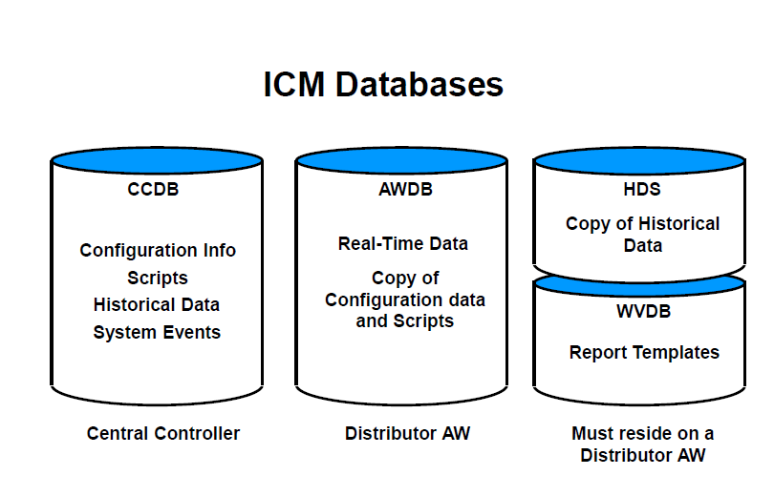
Configuration Manager and ICM Databases
  The 2 Primary configuration tools on the AW are Configuration Manager and the Script Editor
  Configuration Manager
  We use configuration manager to configure ICM database to add Calltypes, Dialed numbers, skill groups, assign dialed numbers to call types and so forth..
  Script editor
    One Place for defining routing logic
  ICM Databases
    Central controller Database
    AW
    HDS and DDS
*Copy and paste this text box to enter notations/source information. 7pt type. Aligned to bottom. No need to move or resize this box.
Title of presentation goes here

Slide 18
Fault Tolerance
Central controller failure Scenarios

Slide 19
Fault Tolerance
  The main goals of the ICM’s fault tolerant architecture are to:
  Eliminate all single points of failure that would cause the system to stop
  Provide disaster protection by allowing the major system components to be geographically separated
  Minimize time periods during which the system is non-responsive to call routing requests (for example, while the system is being reconfigured due to a component failure or recovery).
  ICM software uses two approaches to fault tolerance:
    Hot Standby - In the event of a primary process failure, the backup process is activated and takes over
    Synchronized Execution - all critical processes (Call Router, Logger, and Database Manager) are duplicated on separate computers

Slide 20
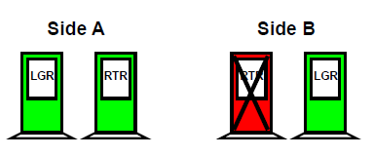
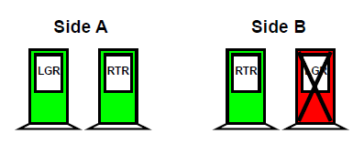
Failure Scenario (Single Router/Logger)
Single Router
Single Logger
  ICM continues to run without interruption
  Central Controller runs as a Simplexed system
  When the Router returns to service, both Routers and Loggers return to Synchronized Execution
  ICM continues to run without interruption
  When the failed Logger returns to service, the Loggers return to Synchronized Execution
Title of presentation goes here

Slide 21
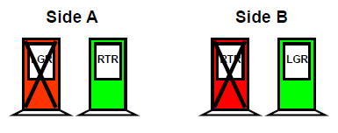
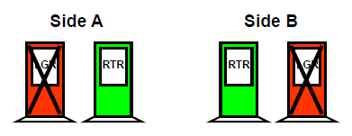
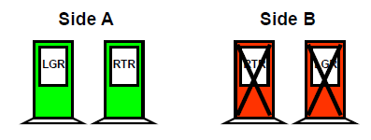
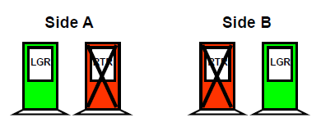
Failure Scenario (Multiple Router/Logger)
  ICM continues to run without interruption
  Data in both Databases slowly becomes out of date and historical data is lost. When both Routers and Loggers return to service, they return to Synchronized Execution
  ICM continues to run without interruption
  All reporting Functions are lost until at least one logger returns to service. Configuration changes cannot be made. Routers use configuration and 0 – 5 minute data in Router Memory to Route Calls
Logger and Router (opposite sides)
Both Loggers
  ICM continues to run without interruption
  Operates in Simplexed mode
  When the failed side returns to service, both Routers and Loggers return to Synchronized Execution
  ICM call routing is temporarily disrupted
  extremely rare
One Side
Both Routers
Title of presentation goes here

Slide 22
Queuing and Self Service

Slide 23
CVP – Cisco Voice Portal
CVP is used for Queuing and self service Applications.
  Self service applications are created with the help of Cisco Call Studio
  CVP Components
  Call Server
    Provides Call Control Signaling
    Interface for UCCE PG – translates CCE VRU commands to VXML
    SIP
  Media Server
    Web server that stores predefined wave files
  VXML Server
    Hosts VXML Applications
  VXML Gateway – IOS Device
  Ops Console
  Call Studio
  CVP Reporting Server

Slide 24
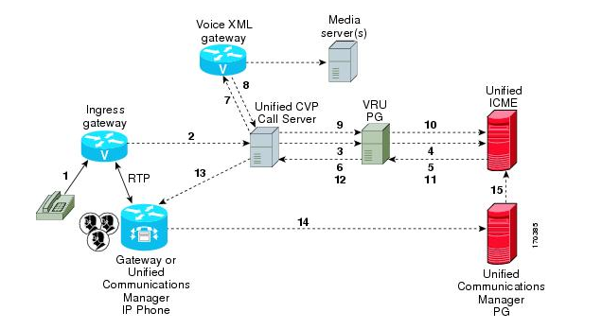
Call Flow

Slide 25
ICM Variables and Scripting

Slide 26
ICM Variables
  Call Control Variables
  The call control variables provide information about the current call request. They include information about where the request came from, call classification data, and information to be passed to the peripheral that receives the call
    CallerEnteredDigits : Digits caller entered in response to prompts
    CallingLineID: Billing telephone number of the caller
    DialedNumberString: Telephone number dialed by the caller
    PeripheralVariable1-PeripheralVariable10: Values passed to and from the peripheral
    RouterCallDay: An encoded value that indicates the date on which ICM software processes the call
    RouterCallKey: A value that is unique among all calls ICM software has processed since midnight. RouterCallDay and RouterCallKey combine to form a unique call identifier
    RoutingClient: Name of the routing client that made the route request
    TimeInQueue: Number of seconds a call has been queued

Slide 27
  Expanded Call Context (ECC) Variables
  Expanded Call Context (ECC) variables are variables that you define and enable in the Configuration Manager to store values associated with the call.
  These are in addition to the variables the ICM software defines for each call (PeripheralVariable1 through PeripheralVariable10, CallerEnteredDigits, CallingLineID, etc.).
  An ECC variable can be either a scalar variable or an array
    Call.user.microapp.media_server
    Call.user.microapp.app_media_lib
    Call.user.microapp.locale
    Call.user.microapp.input_type
    Call.user.microapp.ToExtVXML
    Call.user.microapp.FromExtVXML
    Call.user.microapp.UseVXMLParams
  User Variables
  You can also create global user variables. For example, you could create a user variable called usertemp to serve as a temporary storage area for a string value used by an If node.
    Have a name that begins with user
    Be associated with an object type, for example, Service

Slide 28
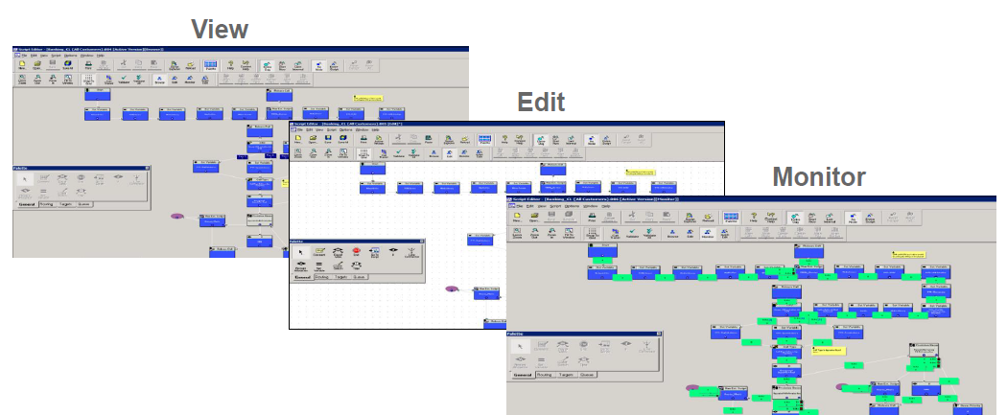
Script Editor Overview
View, Edit, Monitor and Quick Edit

Slide 29
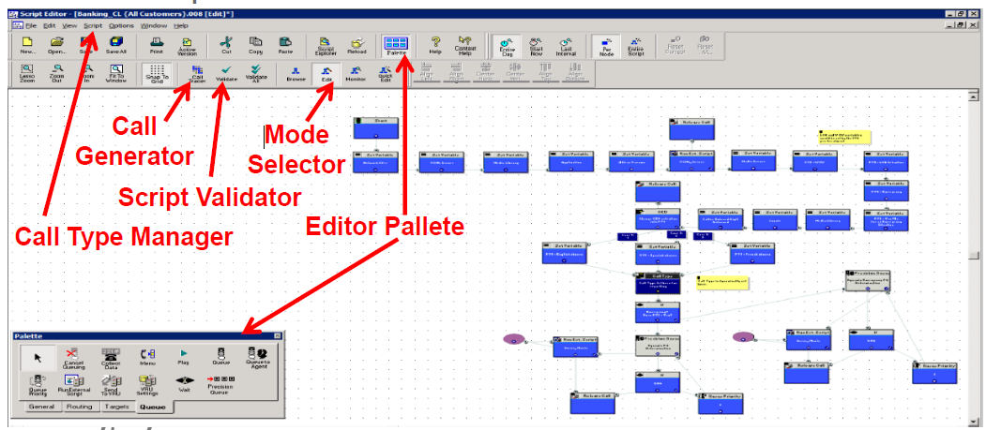

Slide 30
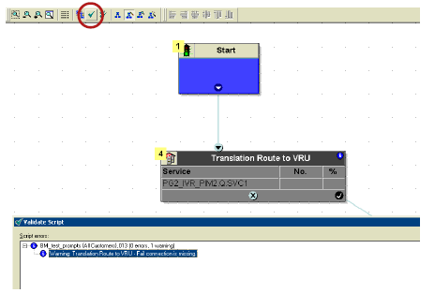
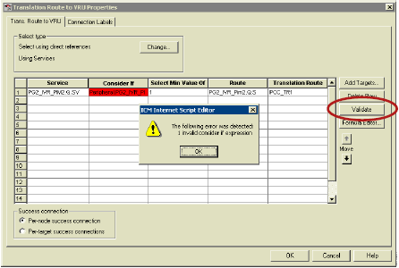
Validate Script
Displays and highlights error
Doesn’t check logic but for syntax
Validate Formula
Highlights offending section
Checks only for mathematical syntax

Slide 31
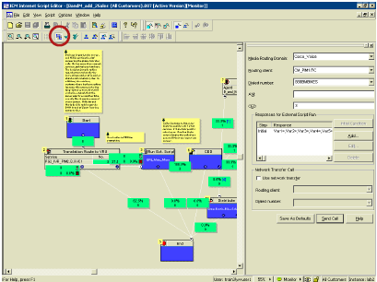
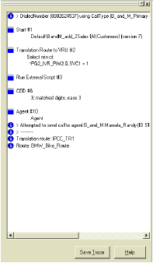
Call tracer
Used for testing the script
Enter parameters like DN,
ANI, CED
Send a call
Follow call flow logic, node by node, in the trace diagram
Trace includes all node IDs as well as all results of all formulas and
variables

Slide 32
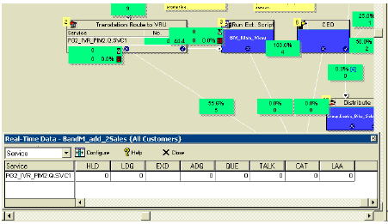
Script Real time
Shows current agent data
Predict routing behavior and check against monitor mode results

Slide 33
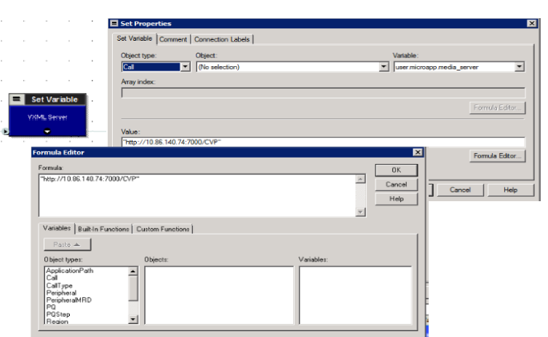
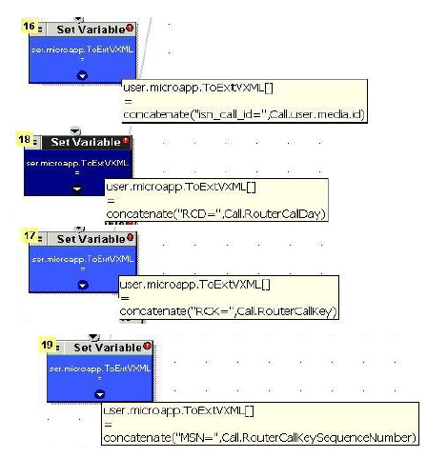
Set variable node: Stores values used in routing decisions in Termination call detail records
Concatenate to store multiple values in one variable location

Slide 34
Nodes
  Set variable
  Run External Script
  If node
  Skill group
  Queue to skill group
  Call Type
  Requalify
  Agent node
  Send to VRU
  Translation route to VRU
  ICM Gateway
  Gateway
  DB Lookup
  Switch
  Day of the week
  Time
  % Allocation
  CED and So forth …….

Slide 35
Micro Applications (Micro-Apps)
  Micro Applications are a set of specific IVR functions that Unified ICM can invoke to enable communication with the caller.
There are six Unified CVP micro-applications.
1. Play Media : Plays a message to the caller
2. Play Data: Retrieves data from a storage area and plays it to the caller in a specific format called a data play back type
3. Get Digits : Plays a TTS or media file and retrieves digits from the caller
4. Menu: Plays a TTS or media menu file and retrieves a single telephone keypad entry from the caller.
5. Get Speech: Collects ASR or DTMF input after prompting a caller
6. Capture: The Capture (CAP) micro-application enables you to trigger the storage of current call data at multiple points in the Unified ICME routing script.

Slide 36
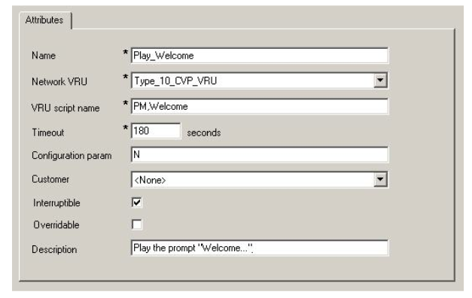
Play Media
Step 1
Microapp Type, Media file name, Media Library type
PM or pm
Media File name :
A file name (for instance, a .wav file)
Null , (user.microapp.inline_tts ECC variable)
-(number 1-10), call Peripheral variables
Media Library Type : A(default),S or V
Step 2 : configuration Param
Barge in allowed : Y or N
Eg:
PM,Welcome
PM,customer.vxml,V,1
PM,-3,A

Slide 37
2. Play Data
Step 1
Microapp Type, Data playback type
PD or pd
Data playback type : kind of data to be played to the caller
Number
Char
Date and so on…
Step 2 : Configuration param
Location of data to be played
Null (user.microapp.play_data)
PV 1 to 10
Barge in allowed : Y or N
Eg:
PD, Number
1

Slide 38
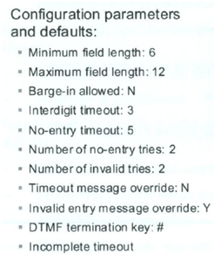
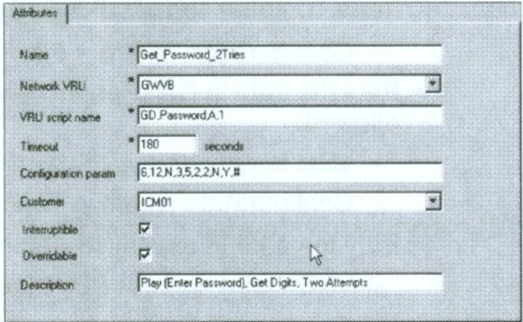
3. Get Digits
Step 1 Microapp Type, Media file name, Media Library type
GD or gd
Media File name :
A file name (for instance, a .wav file)
Null , (user.microapp.inline_tts ECC variable)
-(number 1-10), call Peripheral variables
Media Library Type : A(default),S

Slide 39
Eg:
M, main menu
0-2/9/*/#,,4,2,2
M,-2,S
1-3
4. Menu
Step 1 Microapp Type, Media file name, Media Library type
M or m
Media File name :
A file name (for instance, a .wav file)
Null , (user.microapp.inline_tts ECC variable)
-(number 1-10), call Peripheral variables
Media Library Type : A(default),S
Step 2 : Configuration param
List of menu choices . Valid options are
0-9
*
#
Barge in allowed : Y or N
No entry timeout
No. of no entry tries
No.of invalid tries
Timeout message override
Invald entry message override

Slide 40
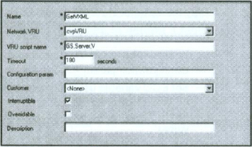
5. Get Speech
Step 1 Microapp Type, Media file name, Media Library type
M or m
Media File name :
A file name (for instance, a .wav file)
Null , (user.microapp.inline_tts ECC variable)
-(number 1-10), call Peripheral variables
Media Library Type : A(default),S
Step 2 : Configuration param
Type of data to collect
Null
Boolean
Date
Currency, number and so on
External grammar file name
Barge in allowed : Y or N
No entry timeout
No. of no entry tries
No.of invalid tries and so on ….

Slide 41
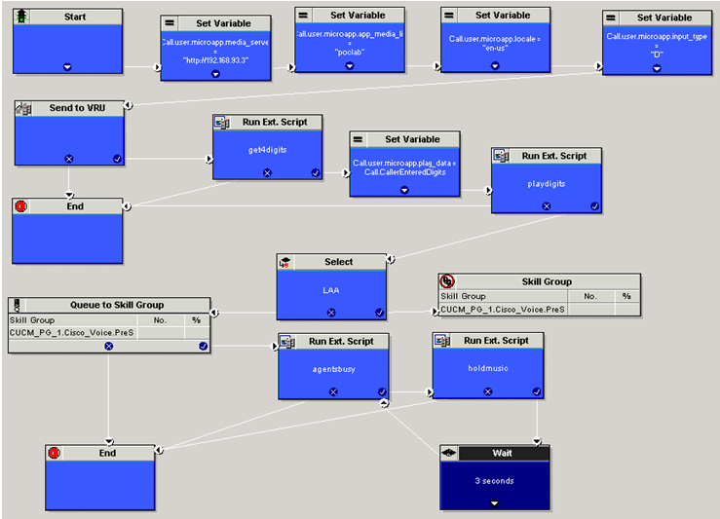
Sample Script

Slide 42
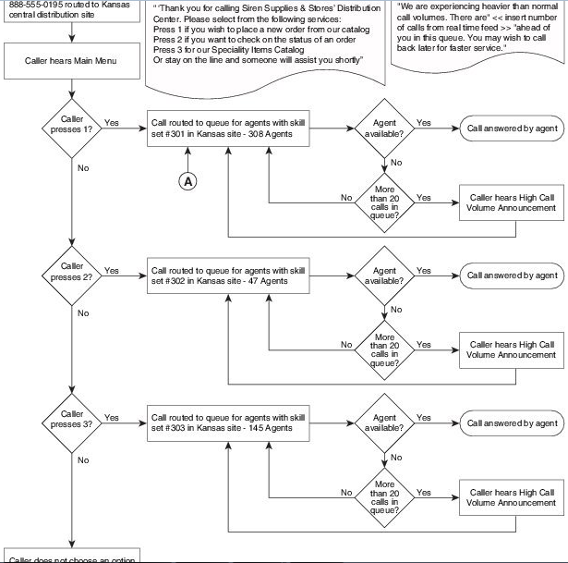

Slide 43
Thank you.
Sreeman Kumar Reddy P
Voice/Data Network Analyst
Sreeman_reddy@optum.com

